Slide 1
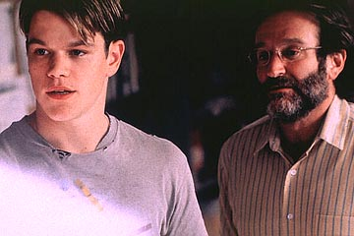
An Overview
Good Will Hunting

Slide 2
Overview
Set in Boston, Massachusetts
Tells story of Will Hunting, a troubled prodigy who works as janitor at the Massachusetts Institute of Technology
His knowledge of and facility with higher mathematics far outstrips that of anyone in the University.
Will must learn to overcome his deep fear of abandonment in order to learn how to trust and love people who care about him.

Slide 3
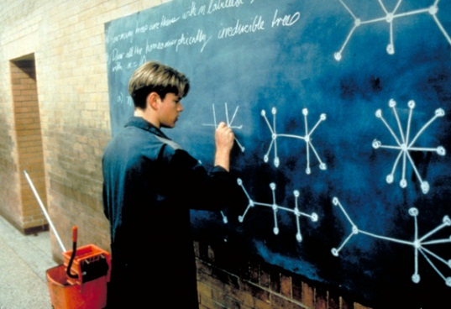
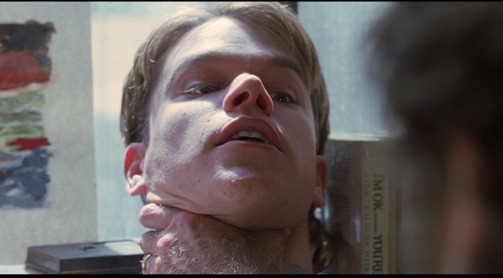
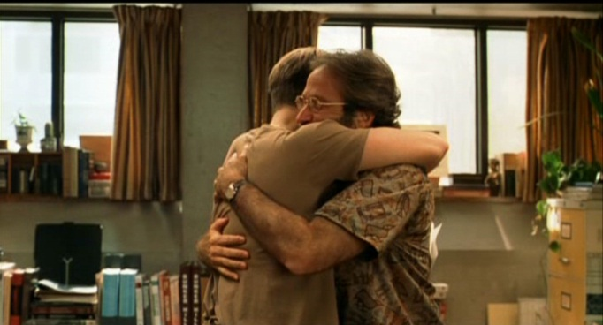
Overview
Story of a young man and his struggle with both himself and personal relationships.
Trying to work through his problems so that he can open up to others and being putting his immeasurable intellectual potential to work.

Slide 4
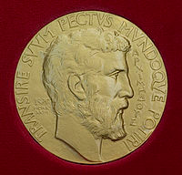
The Fields Medal
Officially know as International Medal for Outstanding Discoveries in Mathematics.
Awarded to two, three or four mathematics not over 40 every four years.
Viewed as the greatest honour a young mathematician can receive.

Slide 5
Attachment Theory
Accepted by most psychologists and psychiatrists as the best explanation for how we develop the capacity to form relationships with others and relate to our environment.
Asserts that the methods we use to relate to others, manage our needs, express our demands, and shape our expectations for the world are rooted in our relationships with our early caregivers.
Through these interactions we learn to balance our feelings and need states with others and to establish our varying degrees of independence, dependence, power, and control.

Slide 6
Attachment Theory
Early attachment is established in infancy and is primarily based on the acknowledgment and gratification of basic biological needs:
the need to eat,
the need to drink,
the need to be comfortable (not cold, hot, or wet)
the need to sleep,
and the need to be free from fear.

Slide 7
Attachment Disorder
Will has a classic attachment disorder.
Abused as a child, has trouble developing meaningful and appropriate relationships with adults and women.
Makes friends with people who cannot begin to complete with his intelligence.
If he has a disagreement with someone or dislikes them, he will assault them either verbally or physically.
His anger is one of his many defences to mask his inner feelings and guard his inner self.
His subconscious is determined that no one will be able to penetrate his defences and hurt him.

